Slide 1

Presented by Galliano, Johnson, Regina, Sun, Yeager

Slide 2

AGENDA
Our project aims to examine the trends between changes in mobility and deviation from baseline and its relationship with COVID-19 cases in the city of Philadelphia. We aim to answer the following questions using this data:
Is there a correlation between percentage of mobility change and COVID-19 cases in the City of Philadelphia?
Do positive/negative spikes in percentage of mobility change affect the spikes in cases?
Which counties were the most/least affected?

Slide 3
HYPOTHESIS
There is a correlation between the increase of COVID-19 that leads to a decrease in mobility in four variables (Retails & Recreation, Grocery & Pharmacy, Parks, Transit Stations, Workplaces & Residential) .
Our Null Hypothesis:
There is no correlation between mobility change and COVID-19 cases in Philadelphia.
Our Alternate Hypothesis:
COVID-19 cases influence the mobility of citizens in the city of
Philadelphia.

Slide 4
COVID-19 DATA
https://github.com/nytimes/covid-19-data
Data was gathered and organized by New York Times journalist
Data was compiled from state, local government and health departments.
CSV was organized by:
-Date county
-Fips
-Cases

Slide 5
COVID-19 COMMUNITY MOBILITY REPORT
https://www.google.com/covid19/mobility/
Data frame was built by Google utilizing maps technology to gather mobility interaction across communities within the following categories: Retail and recreation, Groceries and pharmacies, Parks, Transit stations, Workplaces and Residential
CSV was organized by:
Country, State, County, Fips, Date, Mobility,
Variables

Slide 6
COVID-19 COMMUNITY MOBILITY REPORT
Baseline for mobility: 5 Week period from Jan 3-Feb 6, 2020
Notes pertaining the data:
Collection of data depends on setting from phone users for Google account holders.
As an example Workplaces and Residential might show a decrease in mobility during the weekend.

Slide 7
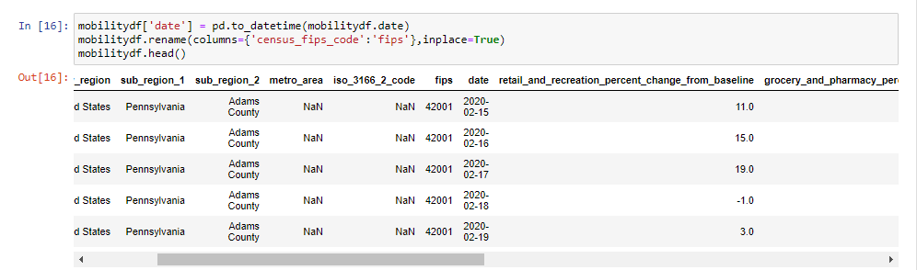
DATA INTEGRATION
Fips header was named differently on both CSV files
- On the mobility report column was named “Census_fips_code”
- On the COVID-19 Cases from NY Times column was named “Flips”

Slide 8
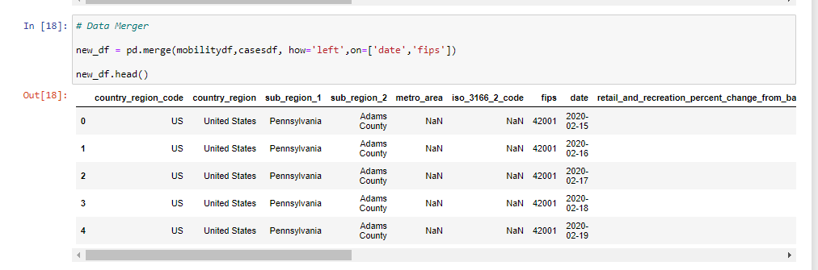
MERGING DATA FRAMES
In order to merge the data on both data frames we used columns for “date” & “ fips”

Slide 9
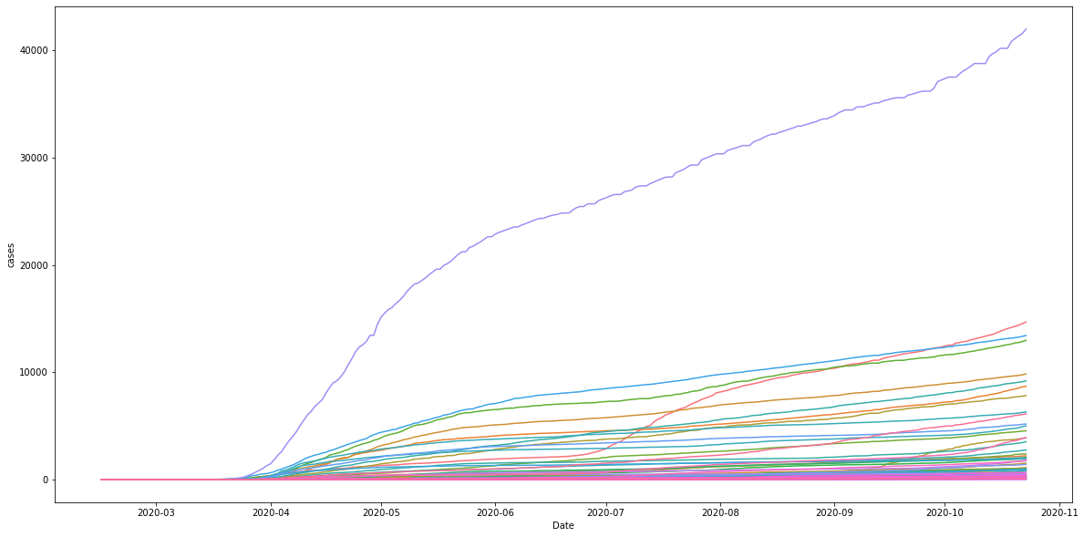
TOTAL AMOUNT OF CASES IN PENNYSLVANIA BY COUNTIES
Based on the graph, we can see Philadelphia being an outlier.
Notes:
Based on the graph, we can see Philadelphia being an outlier.

Slide 10
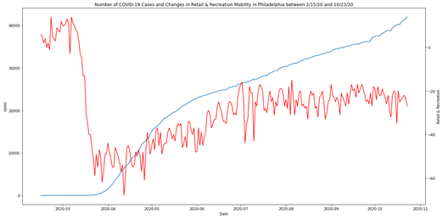

Slide 11
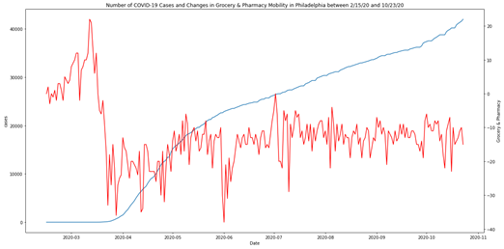

Slide 12
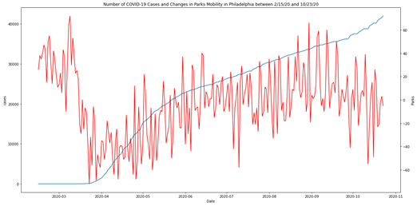

Slide 13
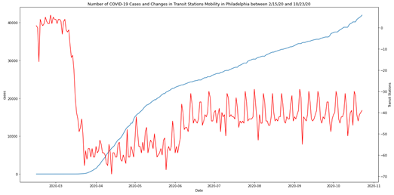

Slide 14
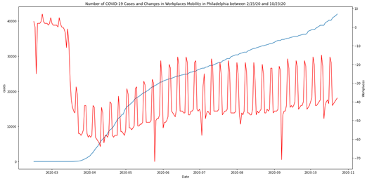

Slide 15
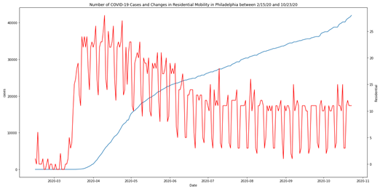

Slide 16
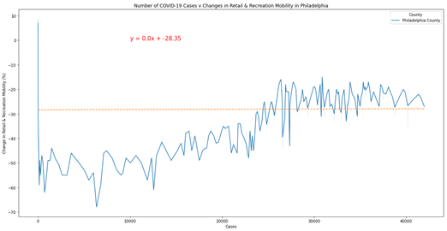

Slide 17
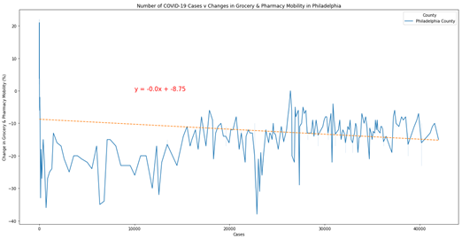

Slide 18
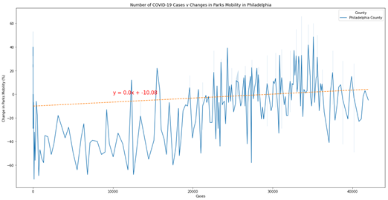
The r-value is: 0.1529158702472844<Figure size 432x288 with 0 Axes

Slide 19
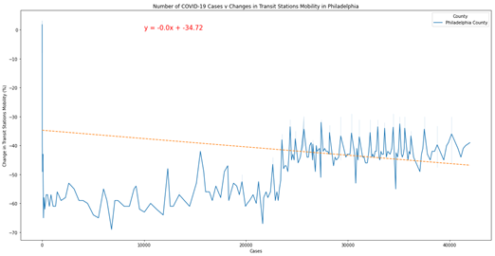

Slide 20
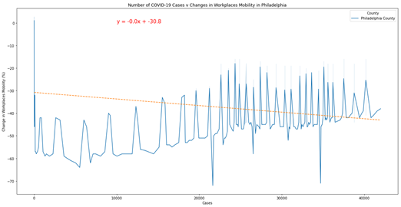

Slide 21
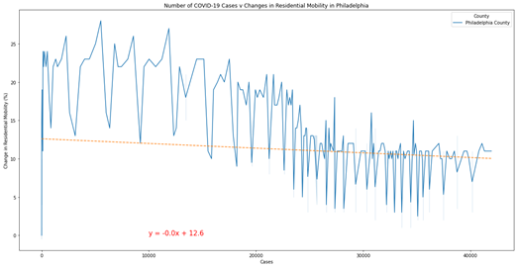

Slide 22
Our data has proved our null hypothesis, pertaining the correlation in the increase in COVID-19 cases and decrease in mobility. It seems like the initial deviation on mobility from the baseline for each of the variables was related to external factors. For example, initial government lockdown and social distancing guidelines.
It is important to note that the limitations of the data that has been gathered by the COVID-19 Community Mobility Report from Google lacks demographics.
Brief explanation about Hypothesis.

Slide 23


